Slide 1

CAR PRICE PREDICTION
Submitted by Puram Naga Raju Internship-23

Slide 2
Introduction
Analytical Problem Framing
Analysis
Limitations
Conclusions

Slide 3
Introduction:
With the covid 19 impact in the market, we have seen lot of changes in the car market. Now some cars are in demand hence making them costly and some are not in demand hence cheaper.
Predicting the price of used cars is both an important and interesting problem. The market value is based on a number of factors, including demand, supply, options, and incentives. The market value of a vehicle usually falls somewhere between the sticker price and the invoice price. Because the market value is an average, some people will pay more than that amount, while others will pay less.
A car's value is determined by many factors: the popularity of the make and model of your car, vehicle specifications, trim levels, physical appearance, mileage, consistent maintenance and working condition.
sing this as a base, I have collected the data from “Cars24” website and here I have collected and scrapped the information of the cars with definite and significant features required for predicting the better model
Once the data is collected, the data will be cleaned and pre-processed with all the necessary tools and the same will be used to build machine learning models in order to predict the price of the same

Slide 4
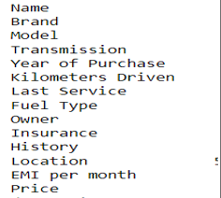
2. Analytical Problem Framing:
Here our dataset has 7039 rows and 16 columns, using this dataset we will be building the model followed by training the data and then finally the model is tested by using 70% of the training data and 30% of the testing data.
The following are the columns or features of our dataset:
These columns are named when the data is collected but during the pre-processing there are few newly created columns which are extracted from the existing data and thus the number of columns increased and the columns are renamed.

Slide 5
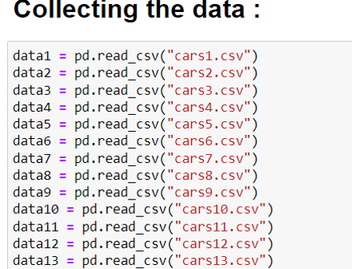
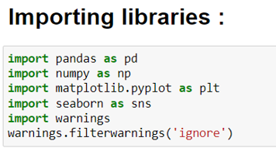

Slide 6
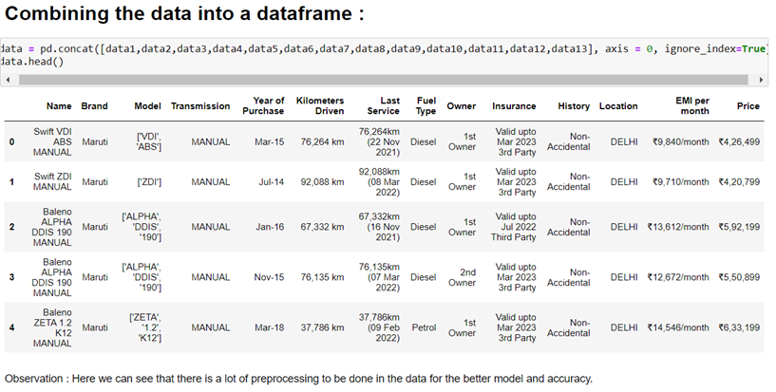
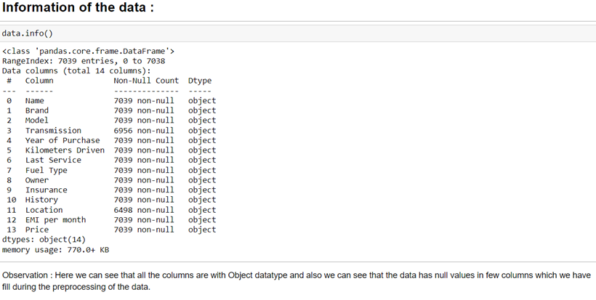
Here the data is concatenated and data frame is formed
Here we have the null values in few columns and also all the features of the data are object type.

Slide 7
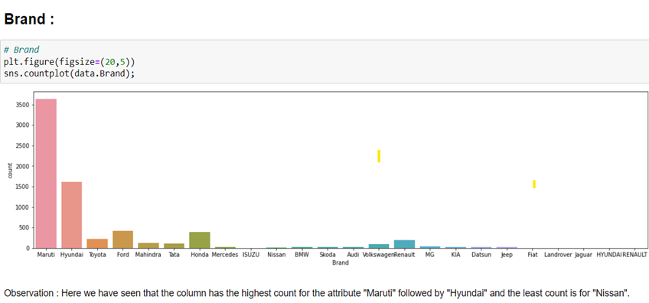
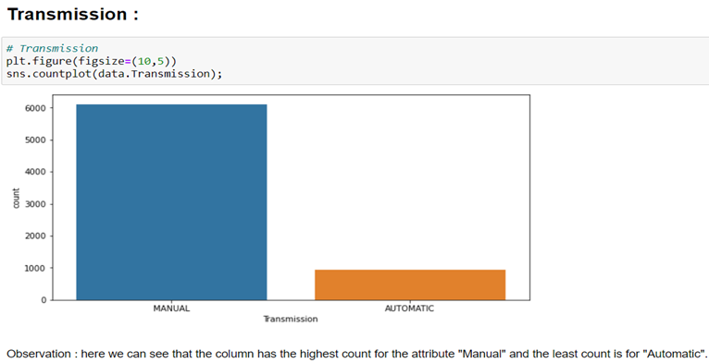
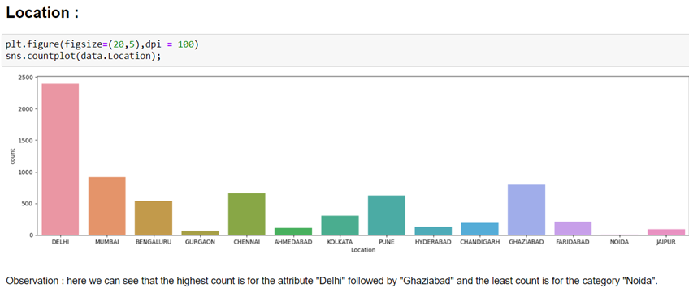
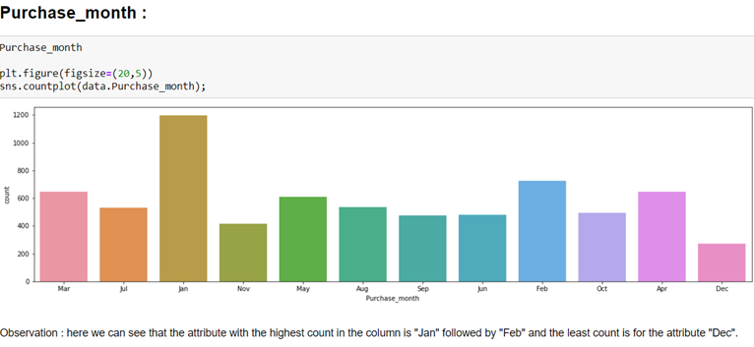
3. Visualization of the data: (Univariate analysis)
Here we are going to visualize few of the feature of dataset:

Slide 8
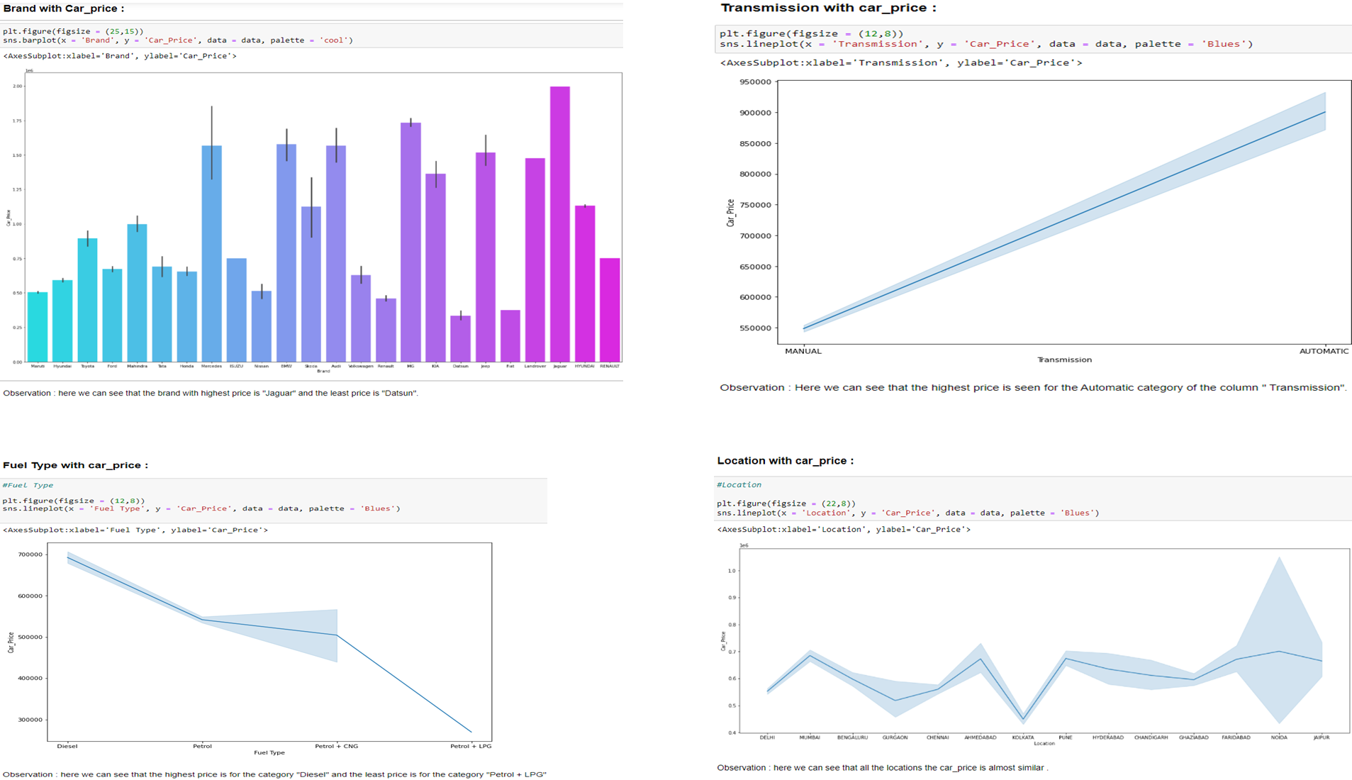

Slide 9
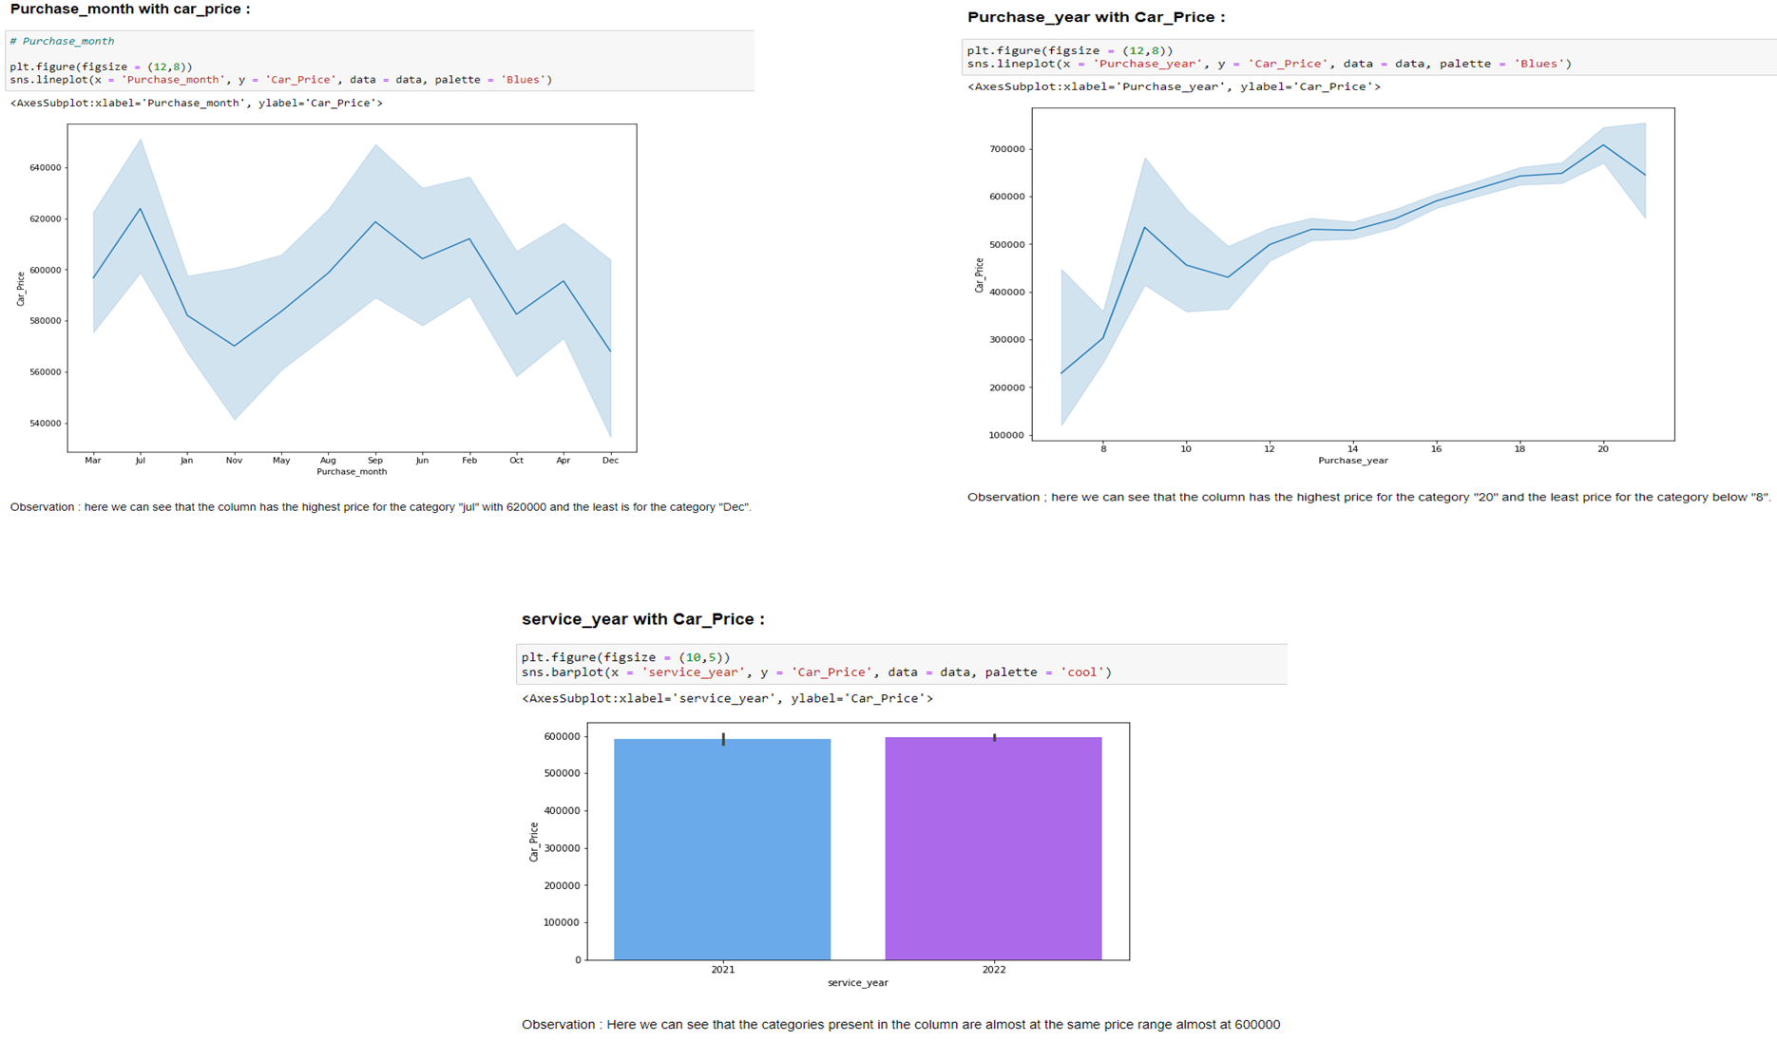

Slide 10
Here the correlation between the features and the variable can be checked and along with which the multicollinearity can also be detected and here the feature “EMI” has the high correlation with our label column.

Slide 11
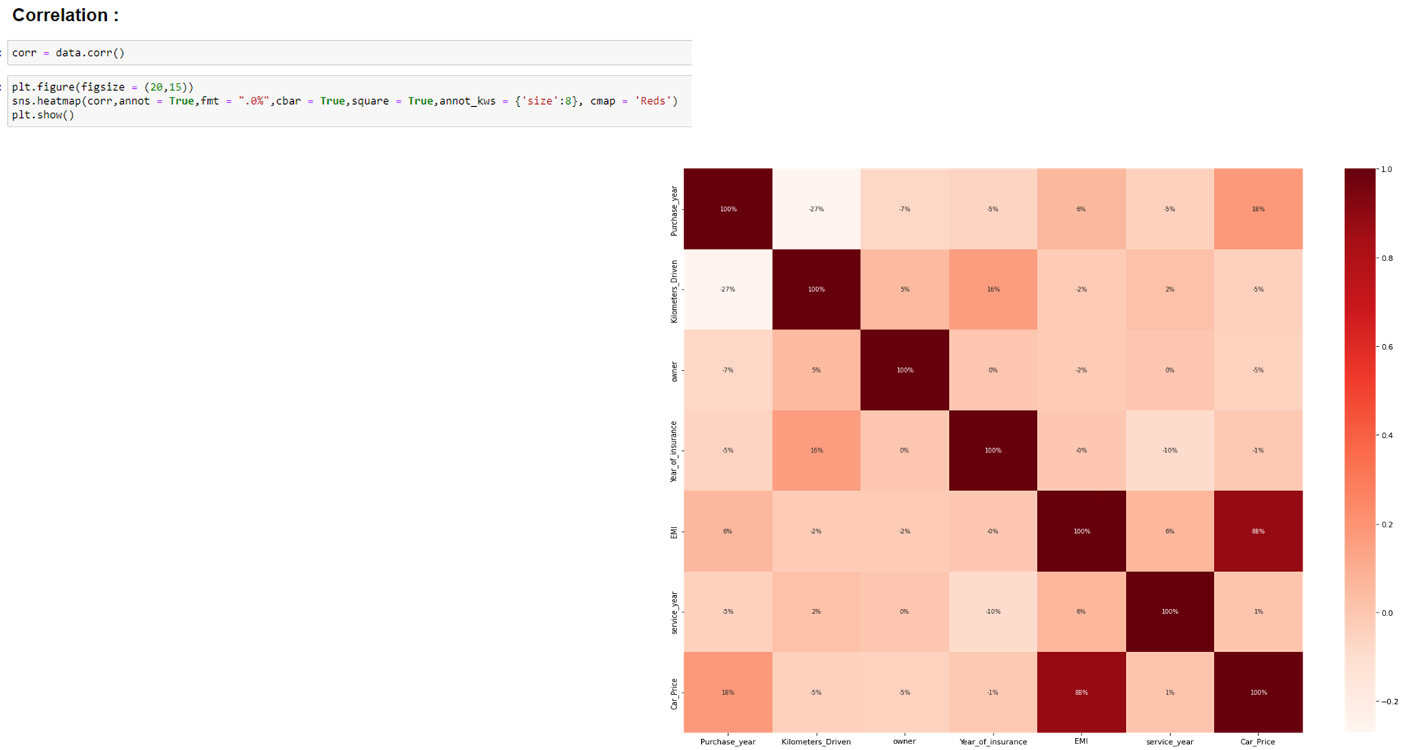
Here the correlation between the features and the variable can be checked and along with which the multicollinearity can also be detected and here the feature “EMI” has the high correlation with our label column.

Slide 12
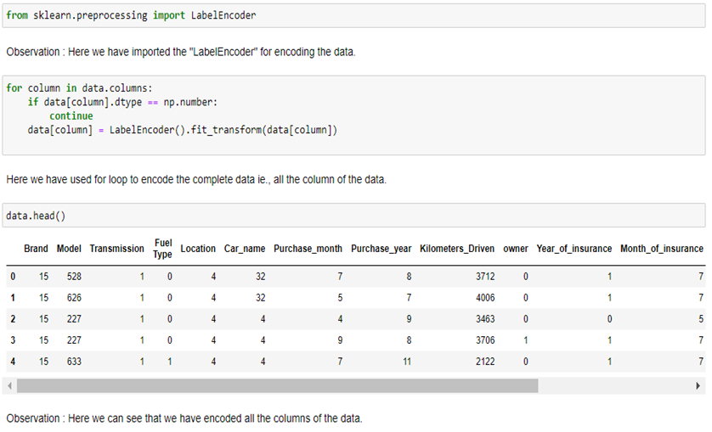
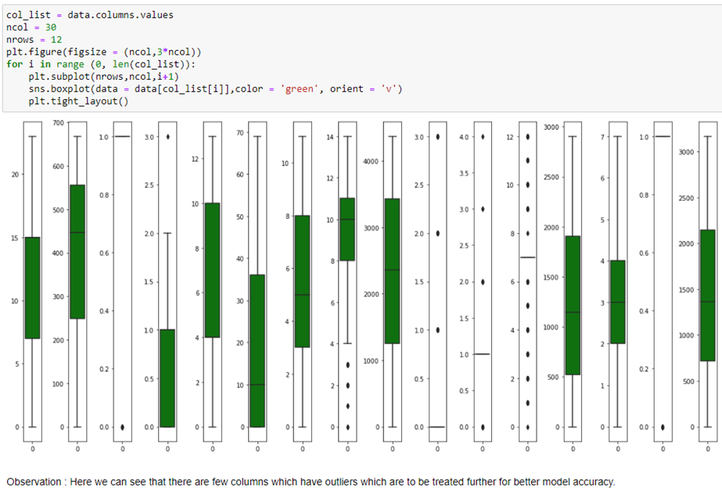
Encoding the data through Label Encoder:
Now we will Check the outliers present in the data:
Here we have encoded the data for further model building in which all the data present in the features are encoded accordingly.
Here we can see that the few features are with outliers and have to treated for better model accuracy.

Slide 13
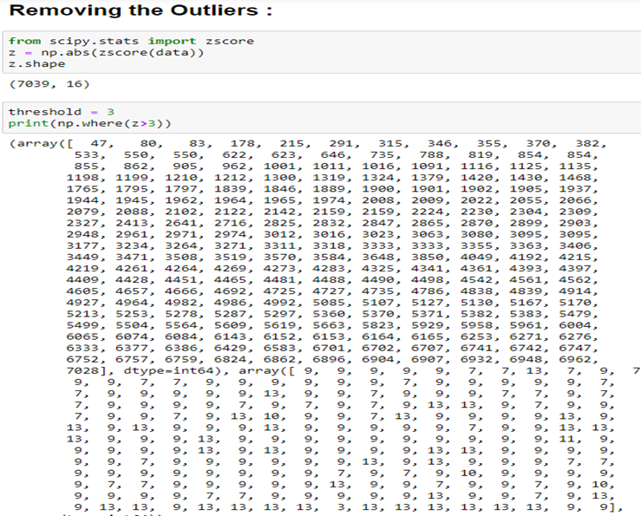
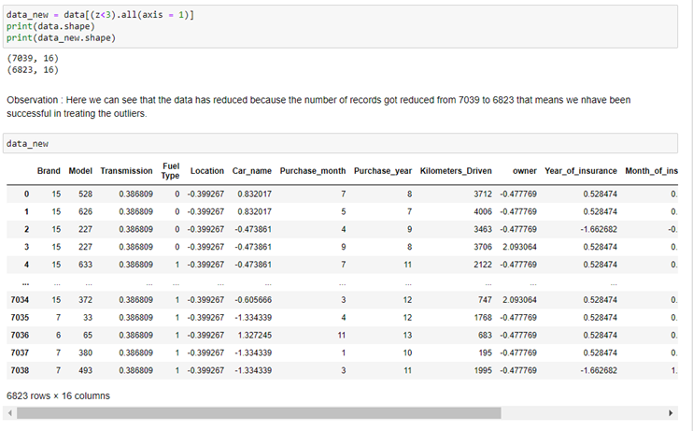
Here we will be removing the outliers through Z-Score method and here we have taken the threshold of 3 for removing the outliers to some extent.
Here we can see that the there is decrease in the number of records which indicates that there is change in outliers to some extent.

Slide 14
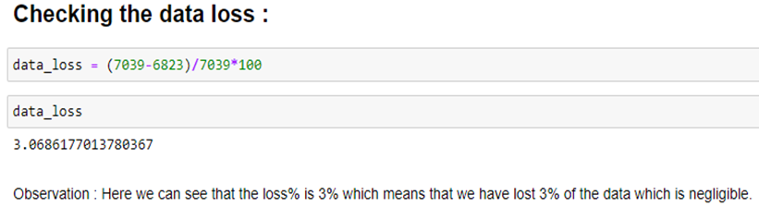
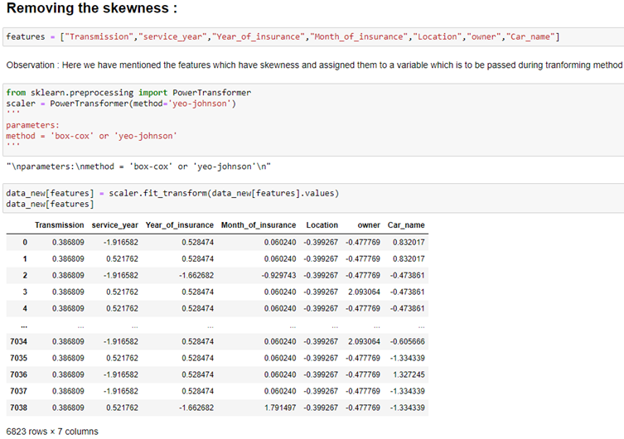
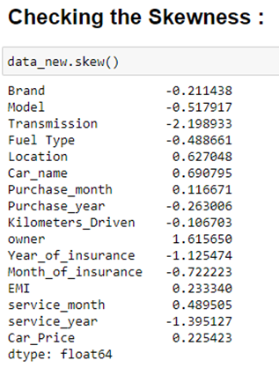
Here we have data loss of 3% which is negligible.
Here the data has skewness and the features are the combination of negative and positive skewness of which the features with negative skewness are more.
Here the features with skewness are passed through ”Power Transformer” method to reduce the skewness

Slide 15
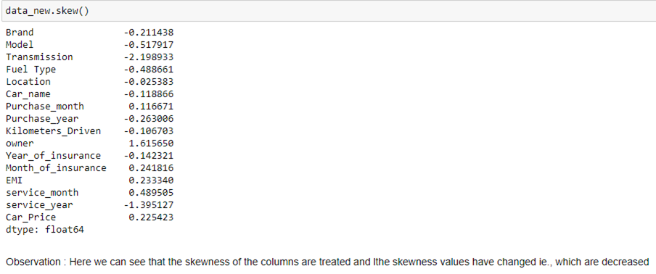
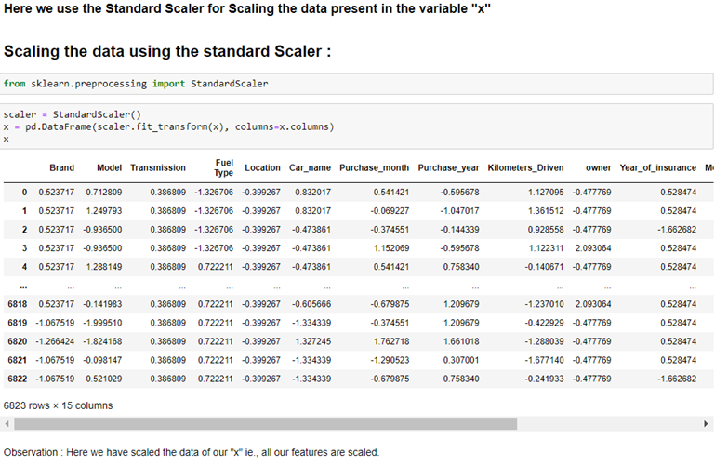
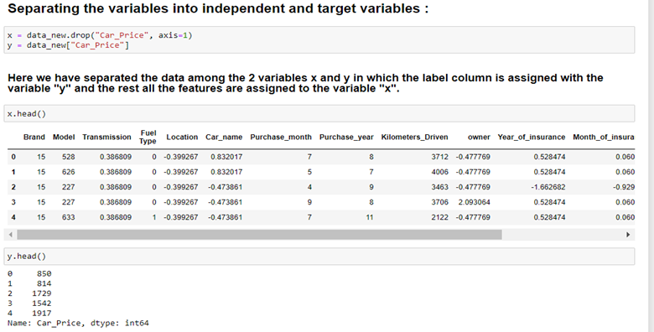
Now we can see the change in the skewness of the features of the data.
Here the features are separated between the variables x and y and the features are assigned to variable “x” which are scaled through Standard Scaler.

Slide 16
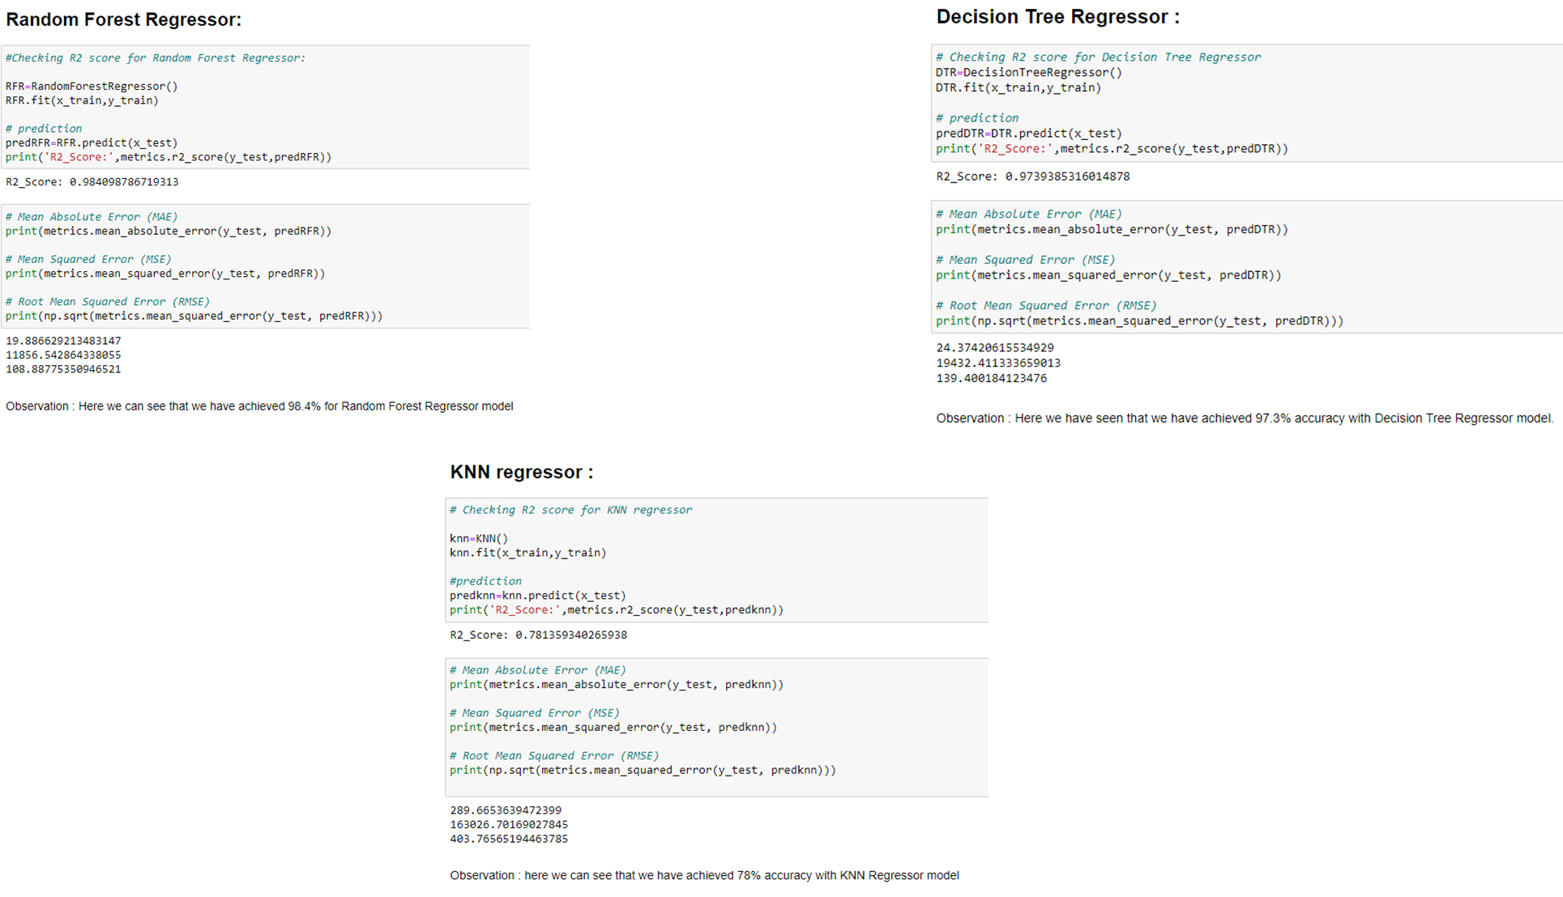

Slide 17
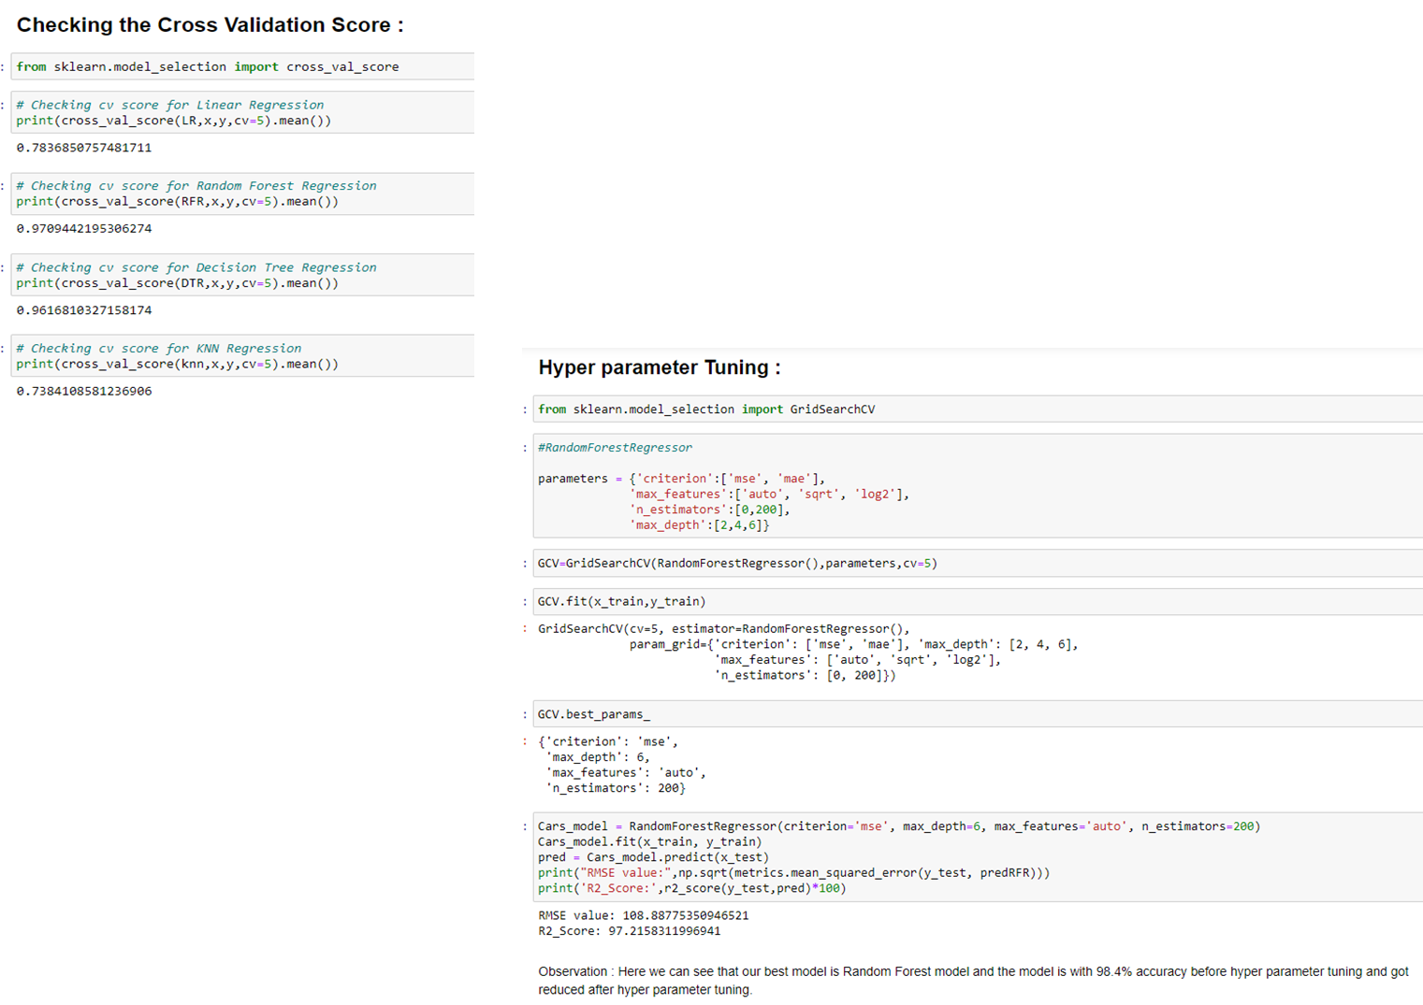

Slide 18
4. Limitations of this work and Scope for Future Work:
Due to the presence of lot of outliers, we are unsure whether the model is going to perform well to a completely new dataset.
During data-collection, there are certain websites that do not provide the necessary information on the used car due to which the data collected was not precise which had to pre-processed for building a better model.
Other than these above limitations, I couldn’t find more scope for improvement.

Slide 19
5. Conclusion
We have successfully built a model using multiple models and found that the Random Forest Regressor model is the best model with a good accuracy.
Below are the details of the model’s metrics predicting the dataset · R2- score of 0.98 · RMSE of 108.88.
You can view the same from the visualizations on the correlation of independent variable over dependent variable (target) As we can see from the boxplot, I couldn’t remove all the outliers yet since the data is expensive, I have to proceed with the dataset with outliers.
Further, I couldn’t get skewness under control for few variables through couple of transformation techniques, yet I have proceeded with building the model. Looking at the heatmap for correlation, I could see there were few independent variables which were correlated with each other, yet I have not removed any variable based on their correlation because multicollinearity will not affect prediction.

Slide 20
THANK YOU !!

